Slide 1


BDM Capstone Project
Smarter Sales & Stock Control for Shivam Book Depot & Stationery Shop
Name : Tripurari Kumar
Roll No. : 23F2003868
Project Source : Primary

Slide 2
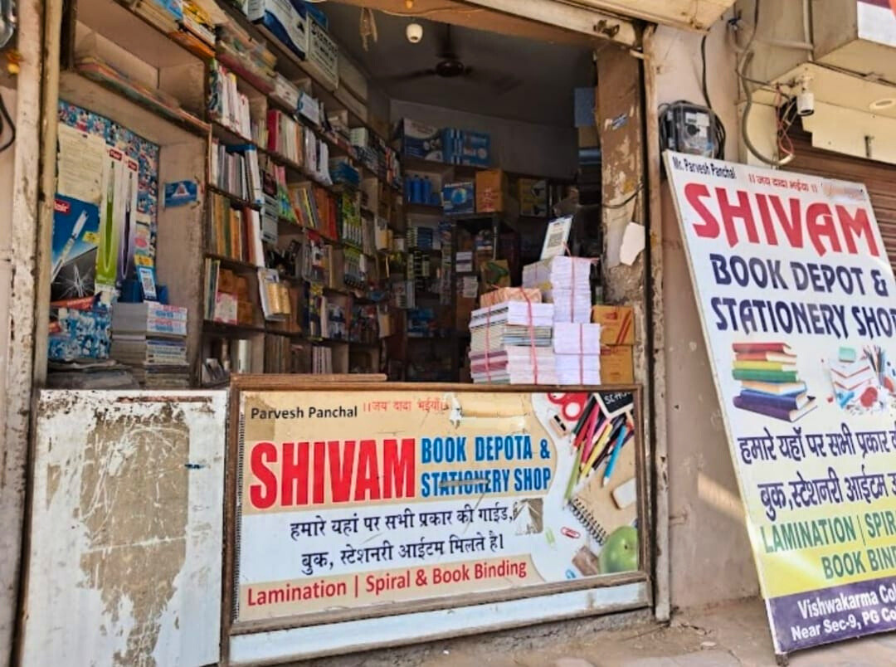
Organization Background
Name : Shivam Book Depot & Stationery Shop
Location : Vixxxxxxa Colony, India
Established : 2020
Type : Local B2C Retail Shop
Customer Base:
School students
College-goers
Office professionals
Key Offerings:
Academic stationery: notebooks, pens, geometry boxes
Basic office supplies
Seasonal demand items (exam/admission months)

Slide 3
Problem Statement
Inventory Management
Lack of Seasonal Planning
Cash Flow Constraints
Overstocking of low-demand items
Stockouts during high-demand periods
No structured preparation before peak months
Unplanned inventory blocking working capital

Slide 4
Data Collection and Methodology
01
02
Primary Data Source
Direct interaction with shop owner
Monthly records from physical registers & Tally exports
Duration: June 2024 – May 2025
Data Types Collected
Monthly sales quantities
Purchase and stock details
Item-wise revenue and inventory
03
04
Important Steps
Data Processed in MS Excel
Cleaned inconsistent spelling & missing entries
Categorized SKUs uniformly
Used 3-month moving averages
Created ABC & Pareto charts
Analysis Techniques
Line Charts for Trend
Pareto Rule (80/20)
CORREL() for purchase vs. sales
Descriptive Stats (Mean, SD, Max)

Slide 5
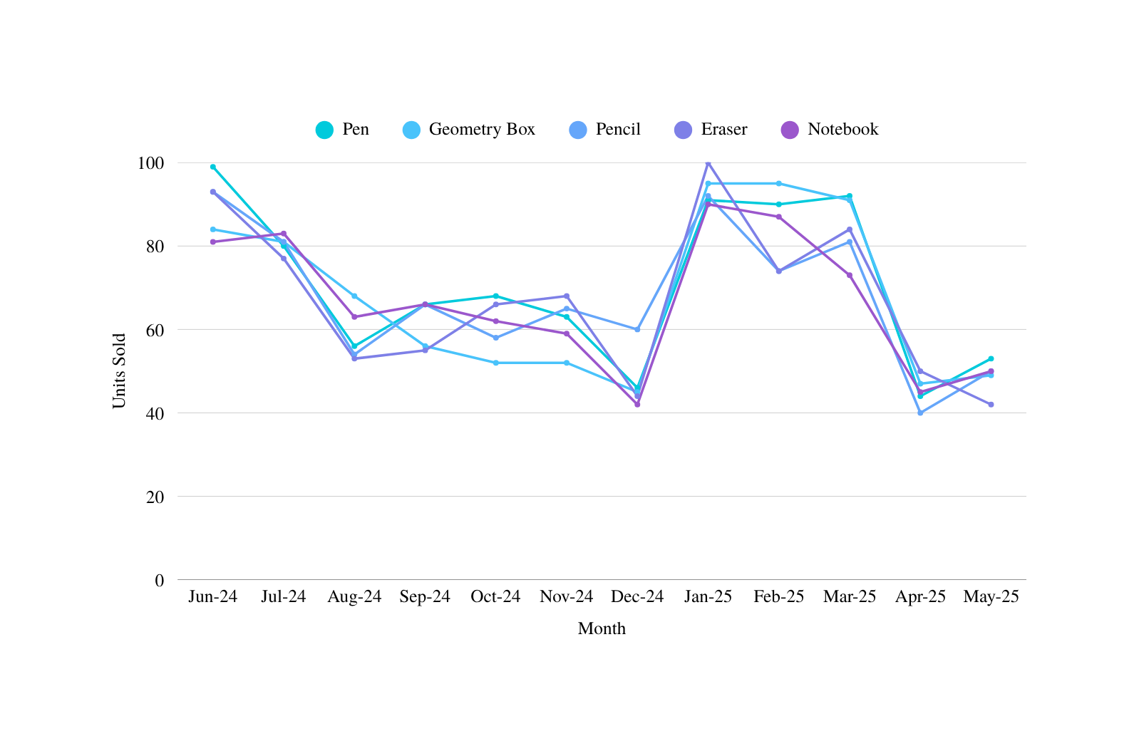
Monthly Sales (Top 5 SKU)
Observations :
Jan & Jun are high sales months.
Pen = most volatile, Notebook = most stable
Sales dip in Aug & Dec

Slide 6
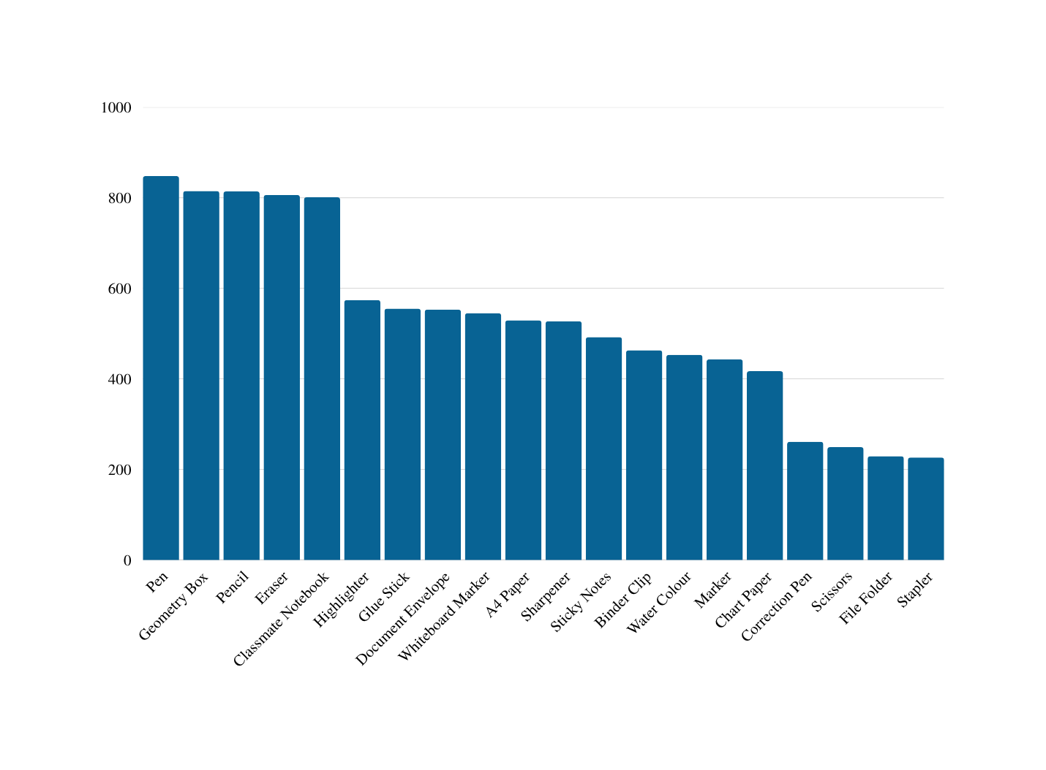

Pareto Analysis
Observations :
80/20 Rule: Few items generate most revenue
Sales drop sharply after top 5–6 products
Focus shelf & stock on top performers
Tail-end items contribute little — stock on demand
Boost top-item sales to reduce dead stock
100%
90%
80%
70%
60%
50%
40%
30%
20%
10%
0%

Slide 7
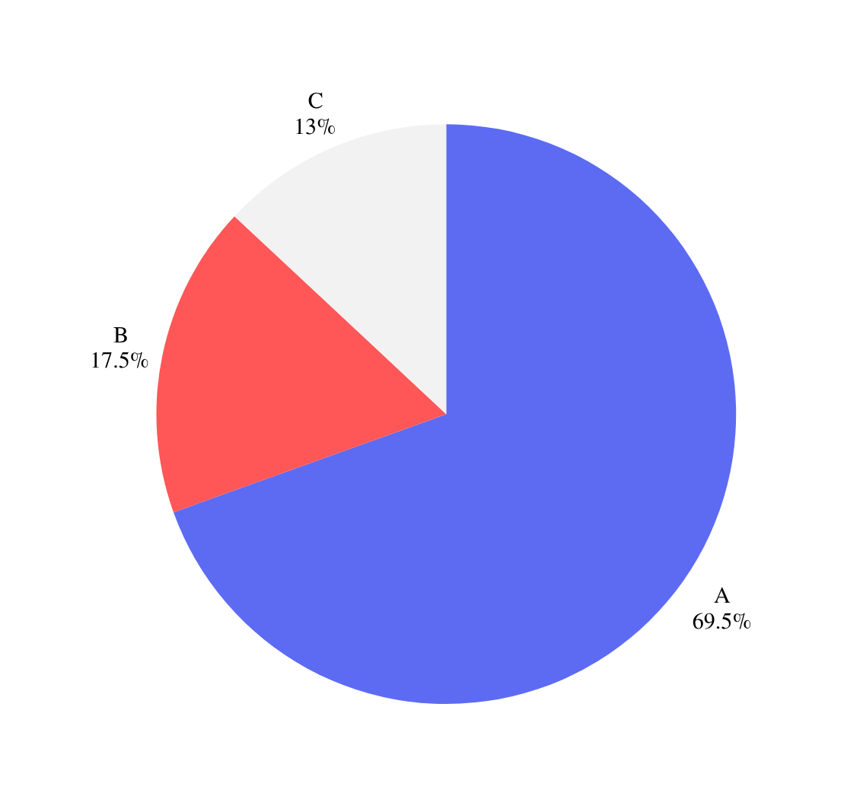
ABC Classification
Observations :
🔵 Category A items contribute ~69.5% of total sales
Must be prioritized for shelf space, forecasting, and fast restocking
Includes top-selling items like Pen, Geometry Box, etc.
🟠 Category B items contribute ~17.5% of sales
Moderate priority — review monthly and stock based on trends
⚪ Category C items contribute only ~13.5% of total sales
Low-impact items — can be stocked on-demand or promoted via offers

Slide 8
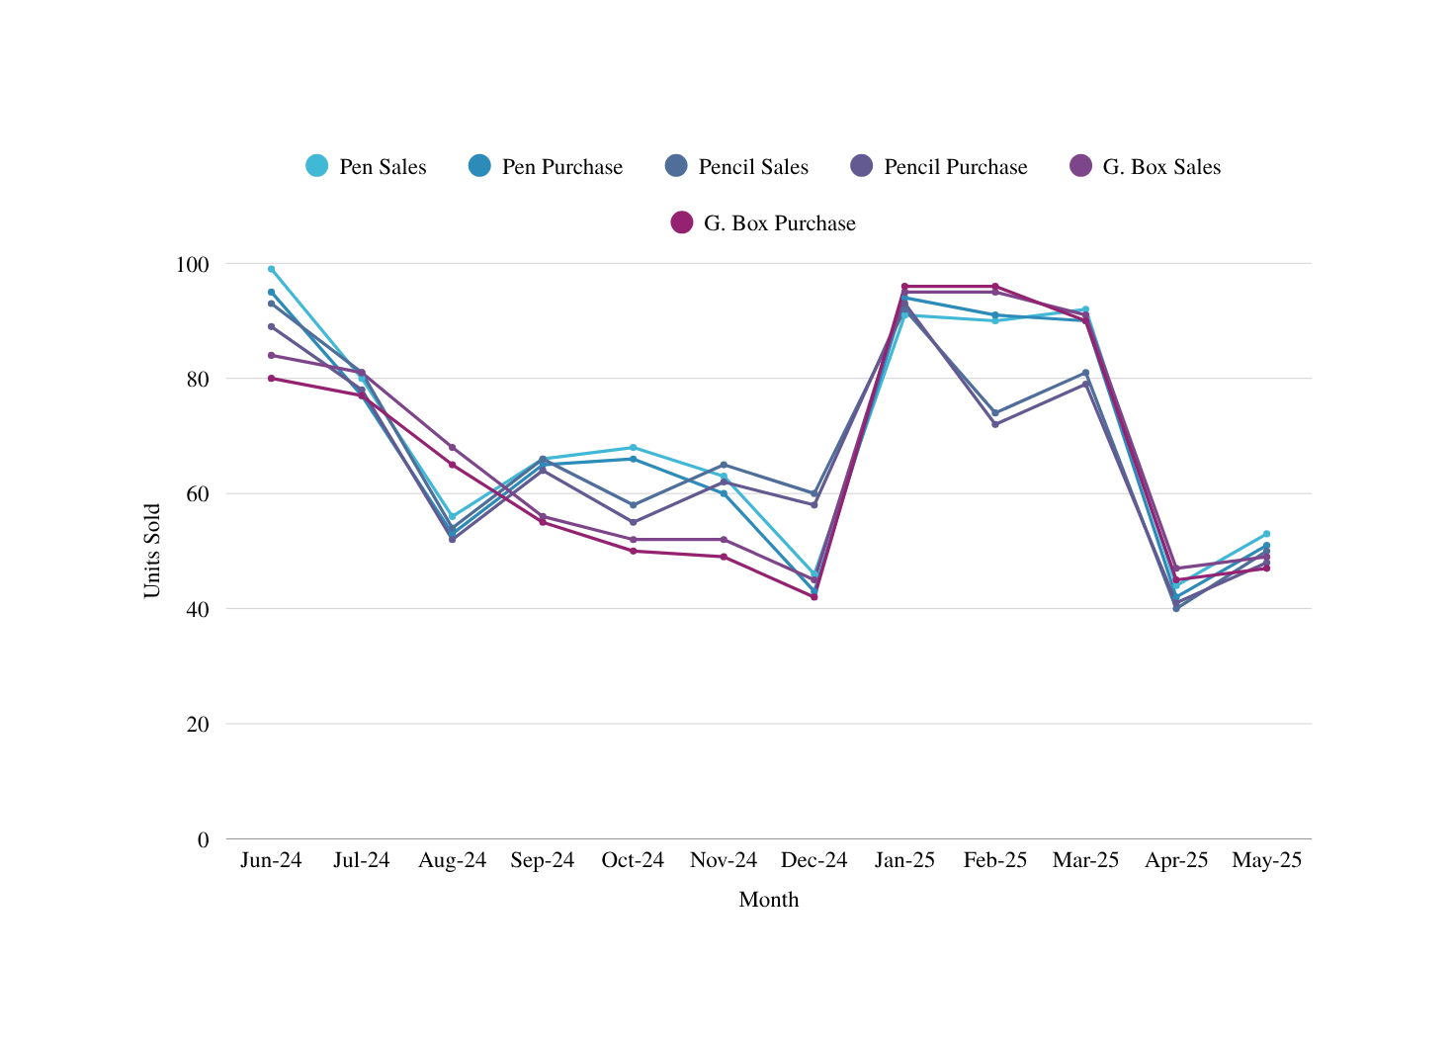
Correlation of Sales vs Purchase
Observations :
Strong correlation (r ≈ +0.99) between sales & purchase
Timely purchase avoids stockouts (10–15 days lead helps)
Dips in Dec & Apr suggest mismatch or low demand
Pen & Geometry Box show high volatility → tighter control
Jan peak = best planning outcome

Slide 9
Key Recommendations
01
02
Smarter Stocking Strategy
Use 3-month moving average for forecasting
Add 30% buffer stock for peak months (Jan & Jun)
Maintain 10–15 days purchase lead time
ABC-Based Inventory Control
A Items (Pen, G. Box): Weekly tracking + dedicated bins
B Items (Pencil): Monitor monthly, mid-priority
C Items (Notebook, Eraser): Clearance or order-on-demand
03
04
POS App & Automation
Implement barcode-based POS (mobile-friendly)
Enable auto sales log + monthly trend reports
Set low-stock alerts for top items
Clearance & Promotion Plan
After 3 months → 10–15% markdown
Bundle low-movers in combo packs

Slide 10

Conclusion & Future Plan
Strategy
01
Impact Delivered
18% reduction in unsold stock
Monthly revenue increased by ~12%
Better shelf turnover & higher customer satisfaction
02
Future Plan
Deploy POS system with auto alert for reorders
Train staff for monthly sales forecasting
Explore online orders for fast-moving SKUs

